Slide 1

Data Analyst Program
Class No. 4 )Group 2)
Final Project
December 2023

Slide 2
Group’s Members:
Eyal Vultz
Yoav Abadi
Oded Mark
Dan Dwek

Slide 3
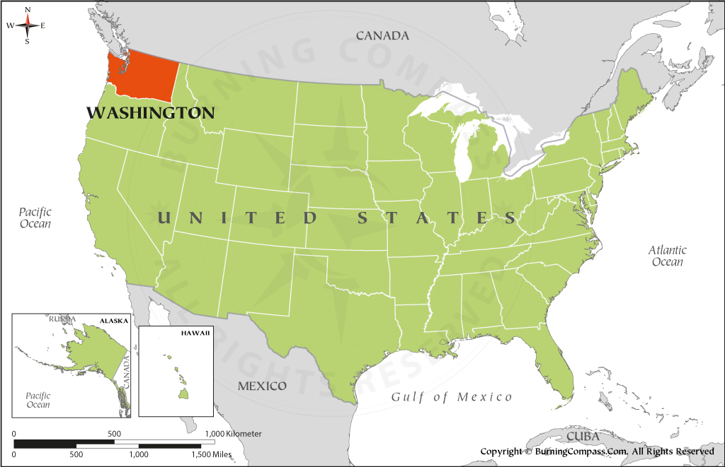

Data Analysis Goal:
Strategy guidance for a short-term investment in a property at Washington, United States.
Data Source:

Slide 4

KPI definition:
Analysis Strategy:
Characterization of properties with the highest probability to gain the highest Revenue in the Coming year*
*Elimination of the seasonality effect, while still being considered as a short-term period.
Top 25% properties according to their Forecasted Revenue in the Coming year
= Price x (365 - availability_365)
Analysis Tool:

Slide 5
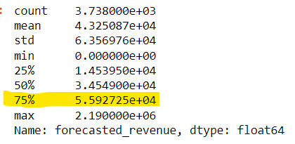
Results:
1. 25% (Q1) of the properties in Washington, United States are forecasted to have a Revenue between 55,927 USD to 2,190,000 USD in the Coming year.

Slide 6
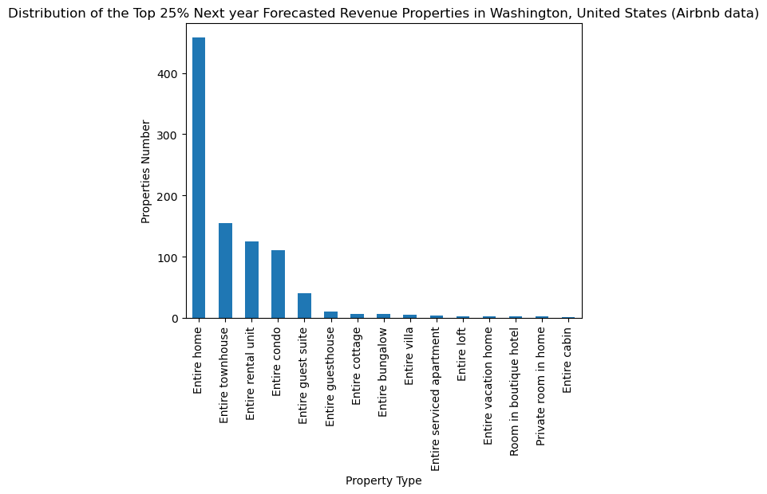
Results:
2. Significantly most of these Q1 properties’ type is Entire home.

Slide 7
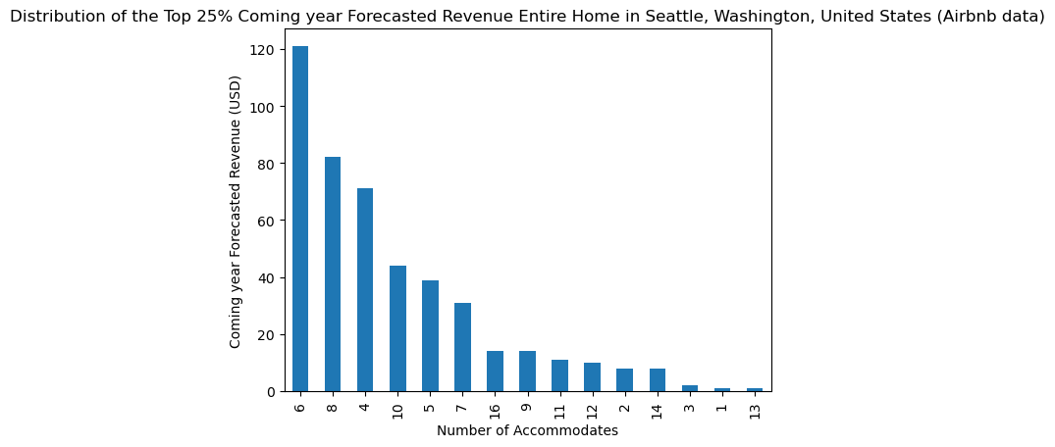
Results:
3. All these Q1/Entire home Property Type are in Seattle.
4. All these Q1/Entire home/Seattle properties’ Room Type is Entire home/apt.
5. Significantly most common Q1 / Entire home / Seattle / Entire home/apt properties are suitable to
Accommodate 6 people.

Slide 8
Conclusion:
The properties with the highest Forecasted Revenue in Washington, United States in the coming year, according to Airbnb data are of Entire Home type, with Entire Home / Apartment room type, located in Seattle, and which are suitable to Accommodate 6 people.

Slide 9
Thank you for your attention!
Any Questions?

